Slide 1
Job Finder
By Deven Joshi
Debasmita Sarkar
Dheeraj Mehta
Gautam Kochar

Slide 2
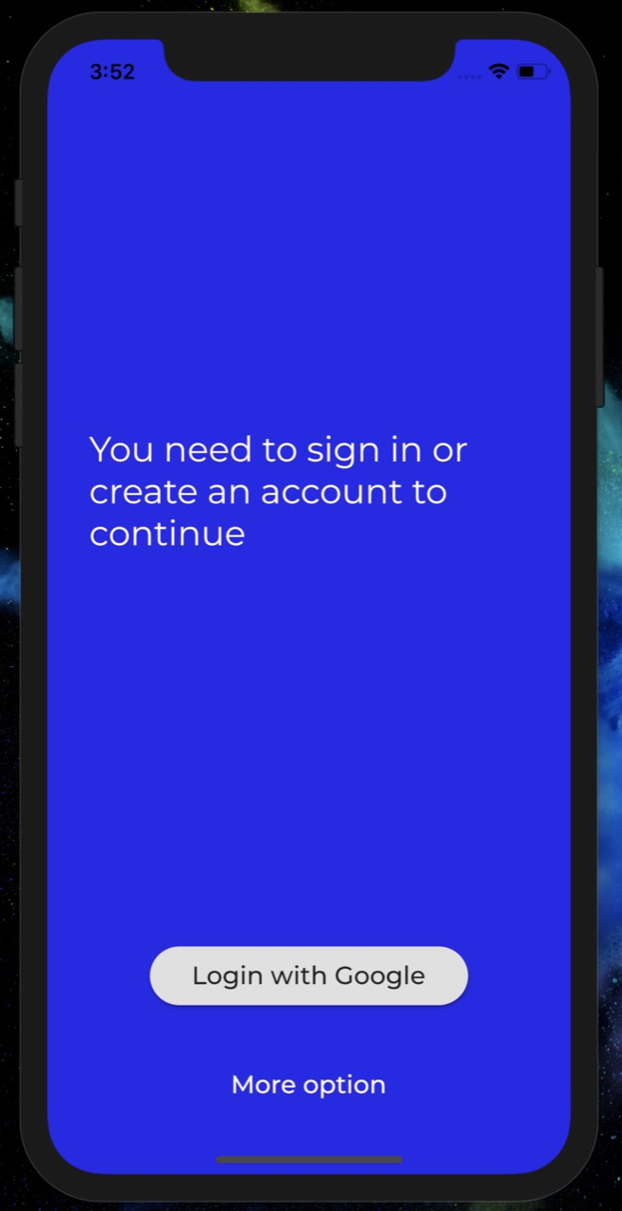
Complete integration with Firebase
Integrates with:
Firebase Auth
Cloud Firestore

Slide 3
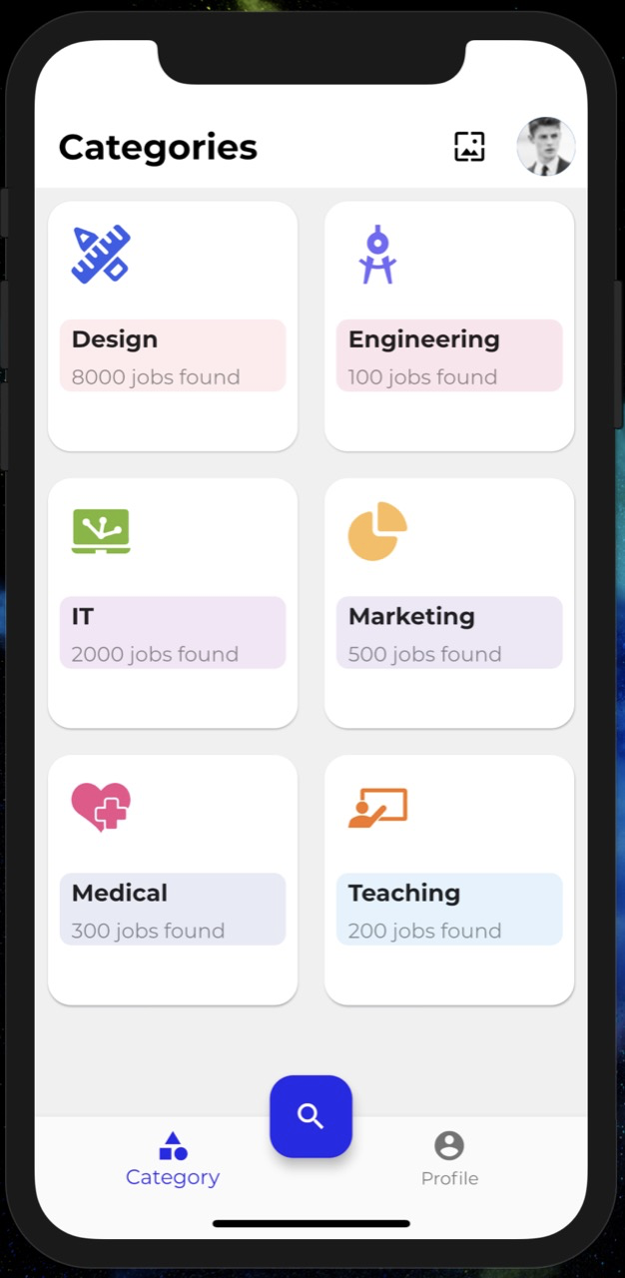
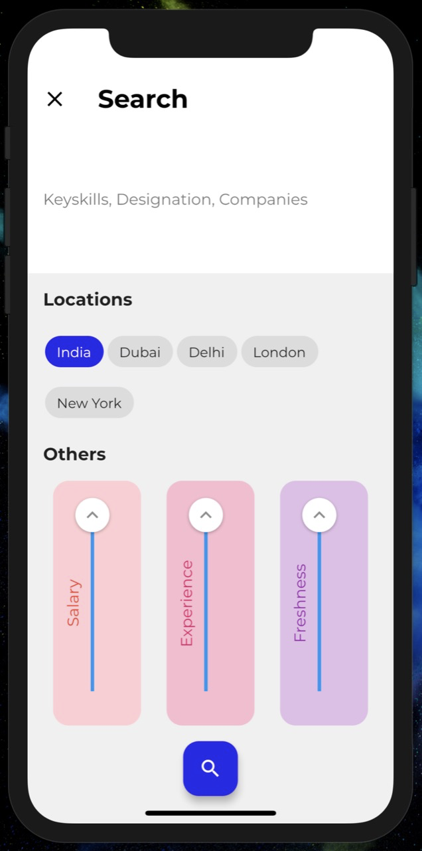
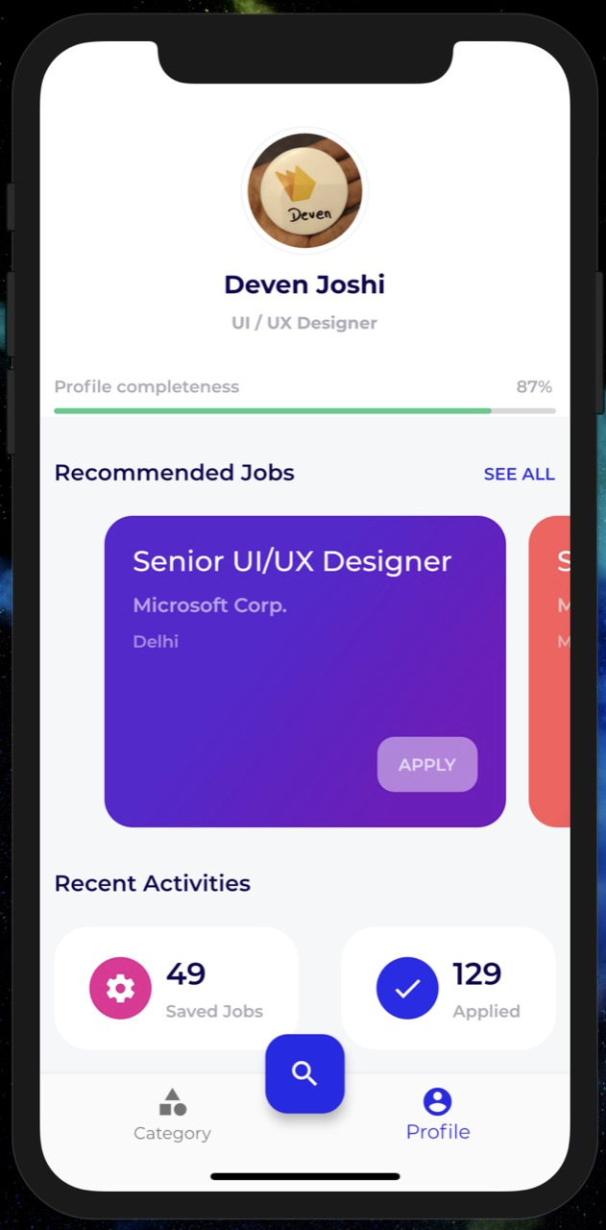
A Clean, Crisp and Intuitive UI

Slide 4
Category-based job search
Jobs are distinguished according to categories

Slide 5
Intuitive Search
Search for jobs with easy to use filters

Slide 6
Minimal User Profile and job recommendations
Quick access to user information and personalized job recommendations

Slide 7
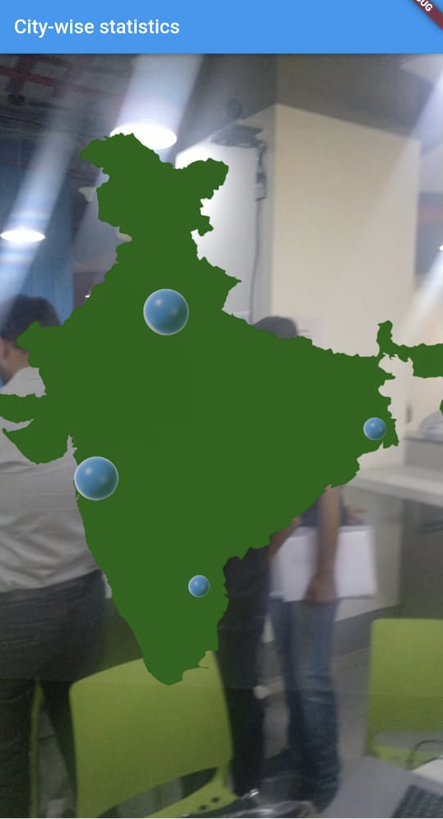
AR Statistical Visualisation
Complex data visualisation made easy using Augmented Reality.

